Slide 1

Handedness in Baseball
Jarrett Markman

Slide 2
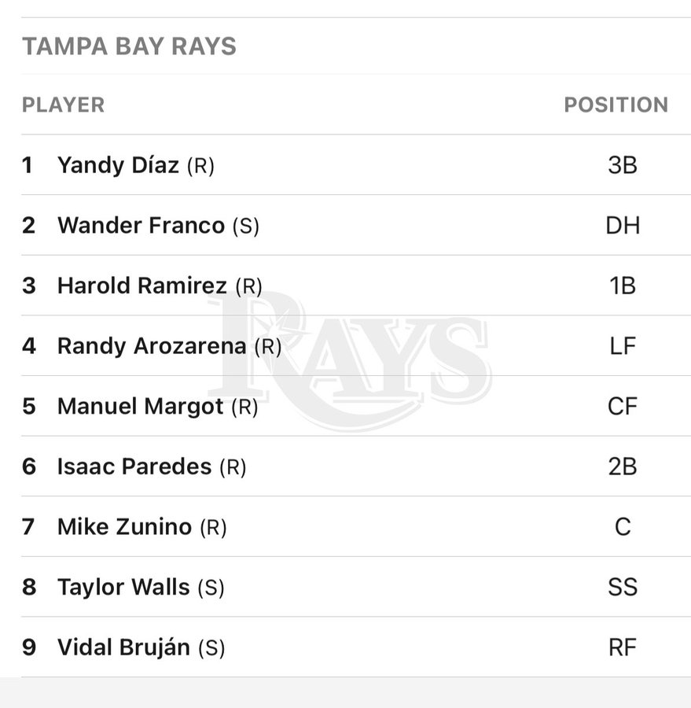
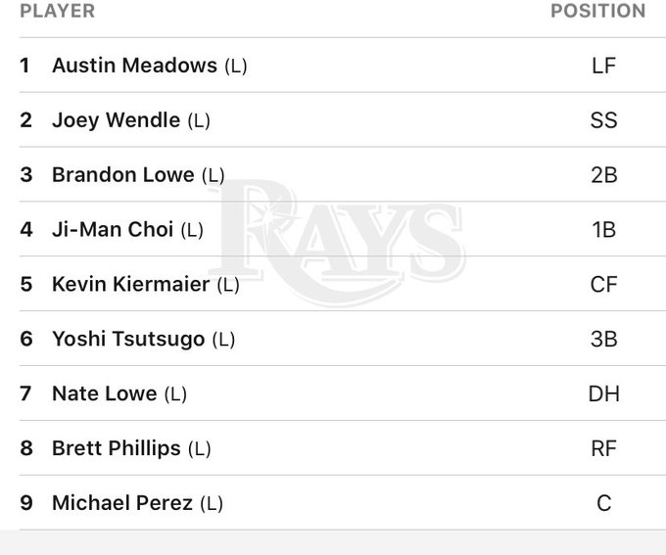
Notes:
When I was younger, my dad told me that facing a left-handed pitcher was easier (I am right-handed). Baseball is one of the most advanced sports analytically. The statistics used to measure many different players are extremely advanced and can measure a variety of variables in the game, such as the ballpark in which a player hits, as well as how efficient they are in being able to produce runs for their team. A team like the Rays are very advanced analytically, with the way they use their lineups and the way they manage their pitchers and relievers. Something that the Rays do is use players against pitchers of the opposing handedness. Given this, it piqued my interest to look at whether teams find more success based on handedness in the MLB. Would an ideal MLB lineup consist of platoon swaps between right-handed hitters against left-handed pitchers and left-handed hitters against right-handed pitching. I decided to use stats like K%, bb%, ISO, wOBA, and wRC+ to measure batter success.

Slide 3

Notes:
For my data collection and analysis:
Used Fangraphs to find all the data and I used excel to compare the data and make graphs. I decided to look at the impact of handedness from the 2018-2021 MLB seasons (excluding the covid year) using a variety of statistics: wRC+, wOBA, ISO, bb%, and k%. I used this data to produce multiple forms of advanced player evaluation in the MLB in order to prevent focusing on a certain group of statistics. In order to evaluate and understand the data, I made graphs and ran a variety of hypothesis tests both through excel.

Slide 4
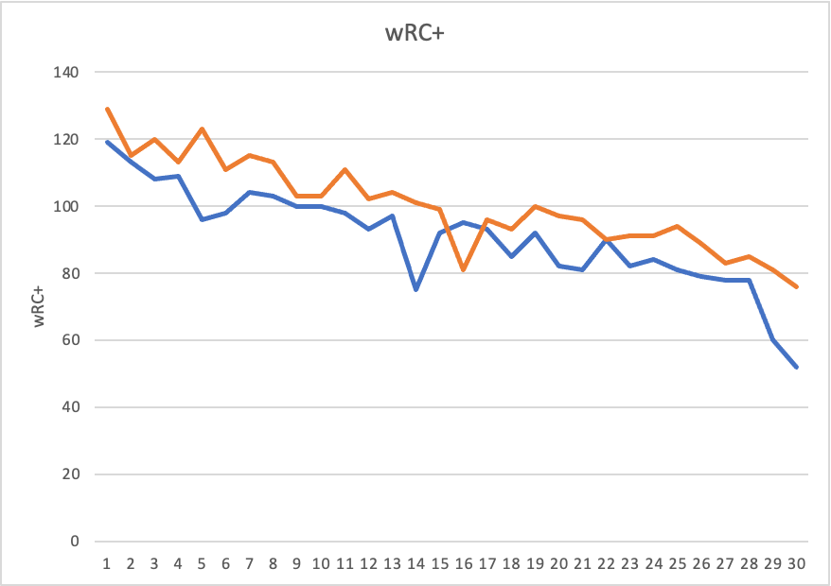
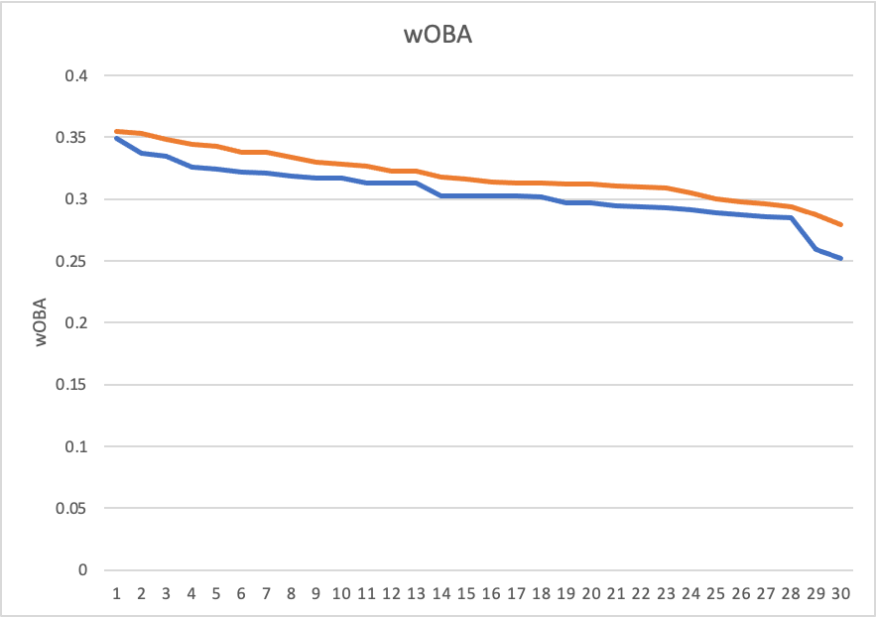
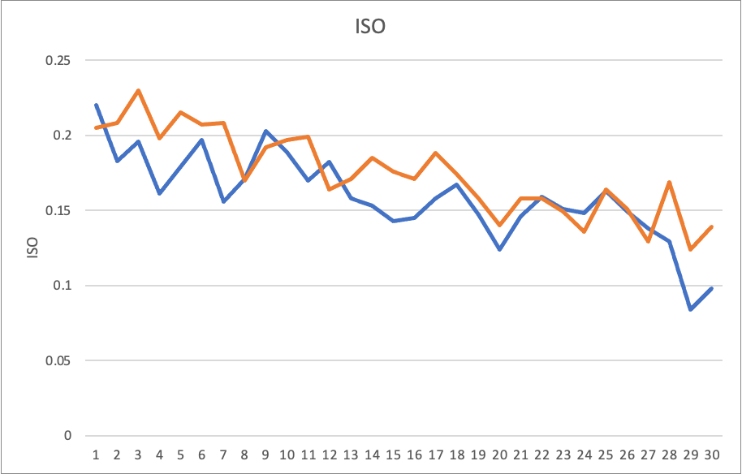
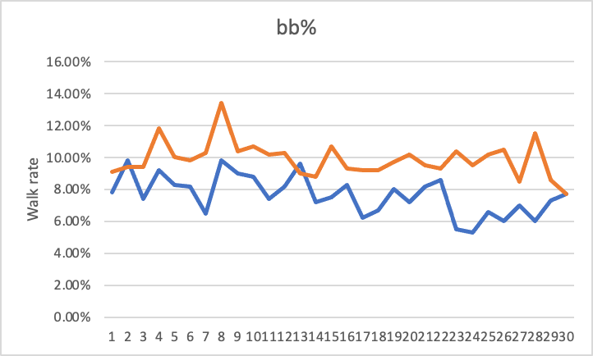
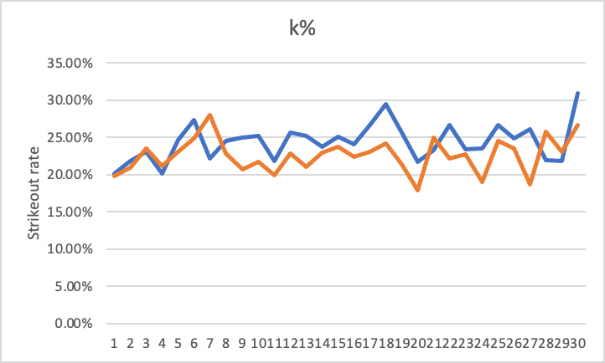
Notes:
2021 data
vR:
Graphs against right-handed pitching
Orange lines indicate the opposite hand, the blue lines represent the same hand.
Very clear that wRC+, wOBA, ISO and walk rates were higher for left-handed hitters over right-handed hitters against right-handed pitchers every team except for a few.
It’s also very evident that strikeout rates are lower for opposing hand batters.
Transition: on to the hypothesis tests

Slide 5
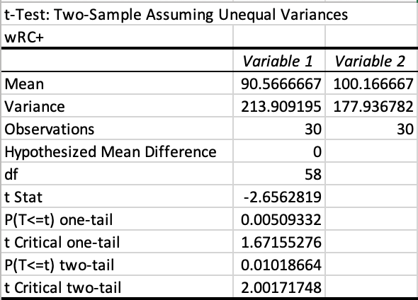
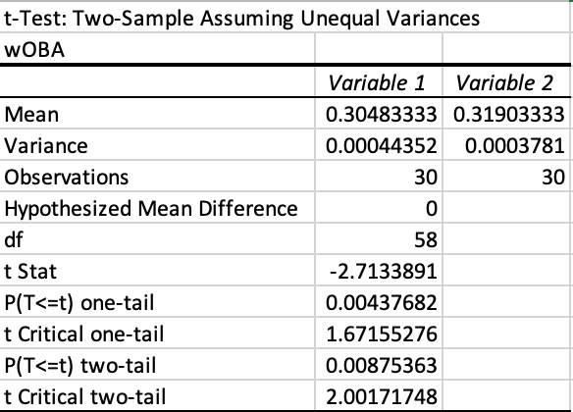
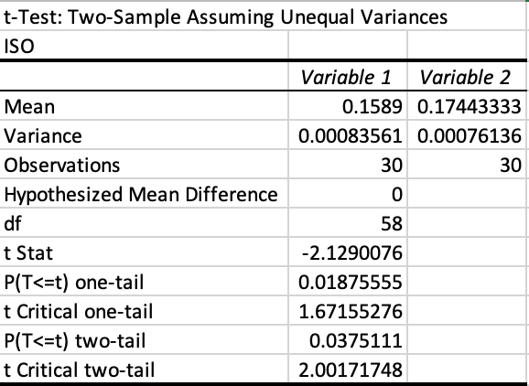
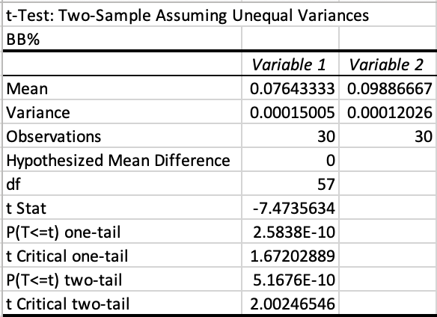
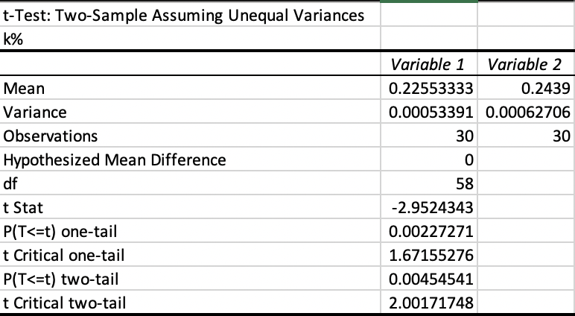
Notes:
wRC+
RESULT: p = 0.005093319 < ɑ = 0.05, meaning we reject the null hypothesis. Since we reject the null hypothesis, that means there is strong evidence that higher wRC+ is linked with left-handed hitting against right-handed pitching.
wOBA
RESULT: p = 0.004376816 < ɑ = 0.05, meaning we reject the null hypothesis. Since we reject the null hypothesis, that means there is strong evidence that higher wOBA is linked with left-handed hitting against right-handed pitching.
ISO
RESULT: p = 0.018755548 < ɑ = 0.05, meaning we reject the null hypothesis. Since we reject the null hypothesis, that means there is strong evidence that higher ISO is linked with left-handed hitting against right-handed pitching.
BB%
RESULT: p = 2.58E-10 < ɑ = 0.05, meaning we reject the null hypothesis. Since we reject the null hypothesis, that means there is strong evidence that higher bb% is linked with left-handed hitting against right-handed pitching.
K%
RESULT: p = 0.002272707 < ɑ = 0.05, meaning we reject the null hypothesis. Since we reject the null hypothesis, that means there is strong evidence that higher strikeout rate is linked with right-handed hitting over left-handed hitting against right-handed pitching.

Slide 6
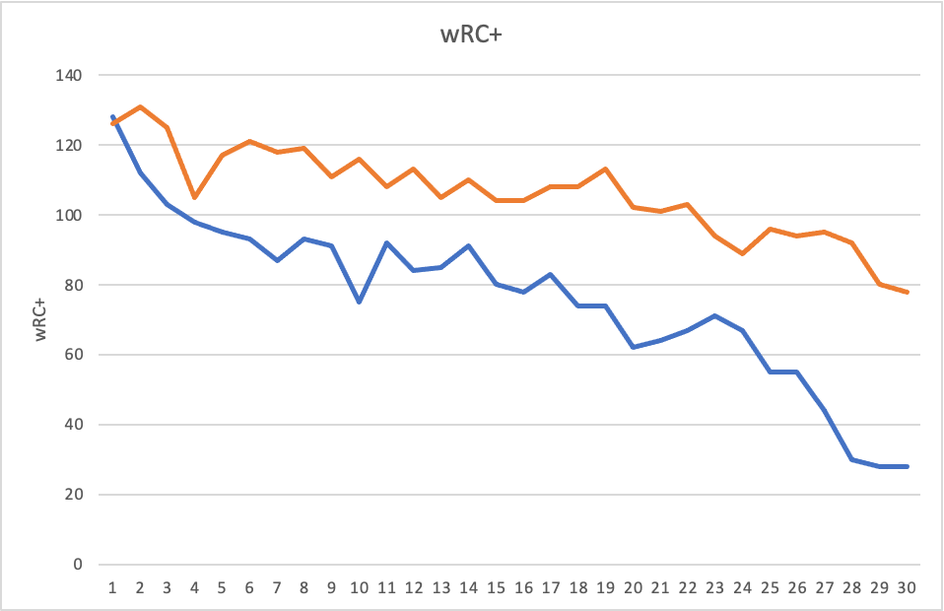
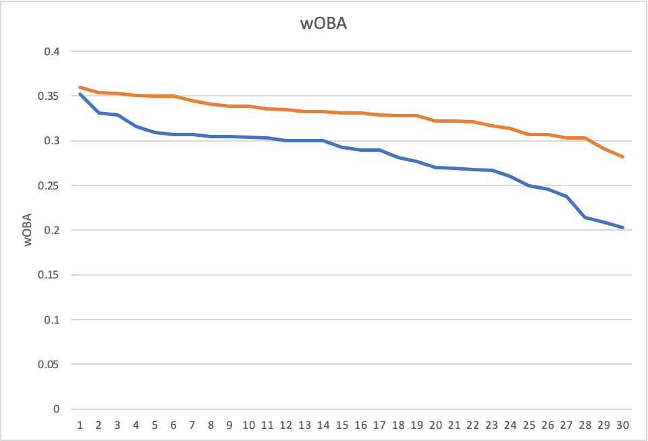
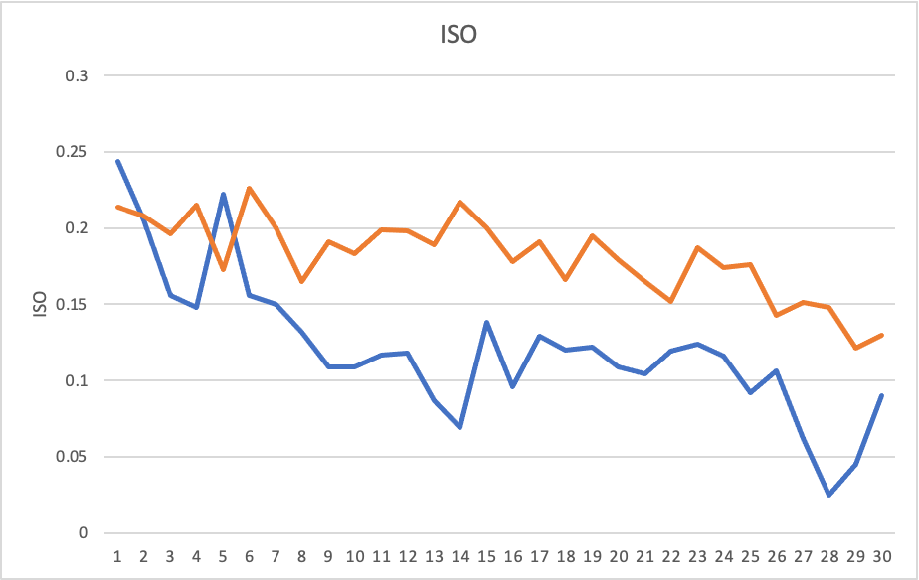
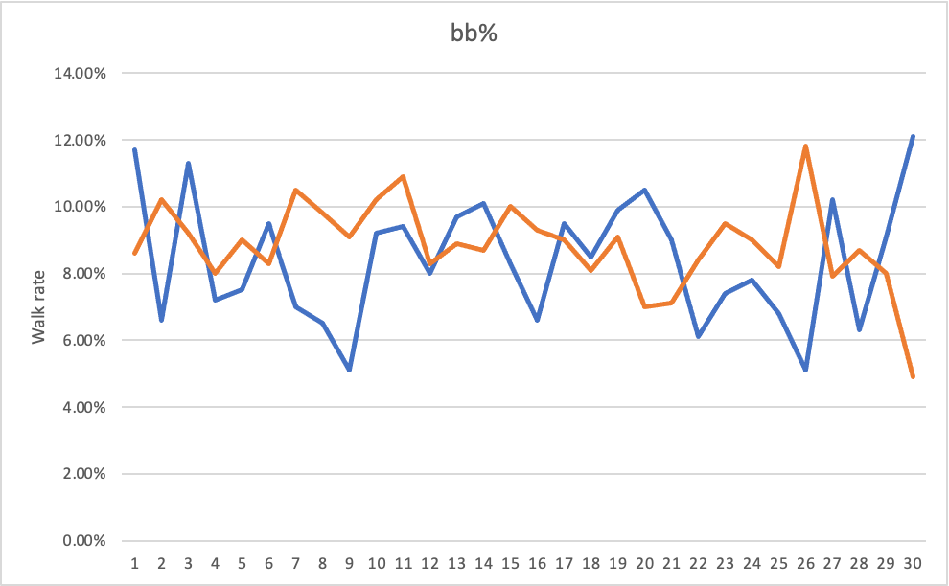
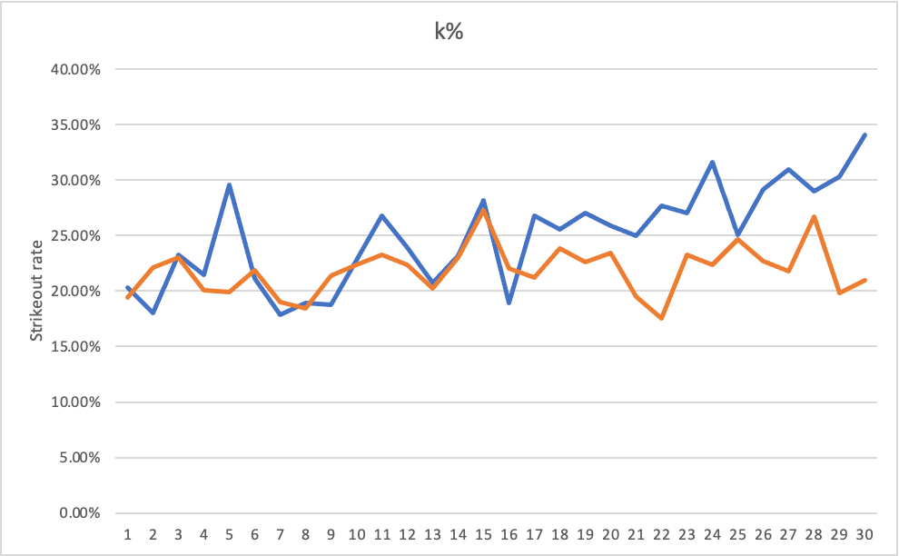
Notes:
vL:
Just like in the line graphs against right-handed pitching
Orange is for the opposite hand (RvL) and the blue is for the LvL
It’s very clear that wRC+, wOBA and ISO are higher for opposite hand over same hand.
Different from against right-handed pitching, plate discipline does not seem to be affected by opposing hand from this year at least. As you can see the graphs fluctuate.

Slide 7
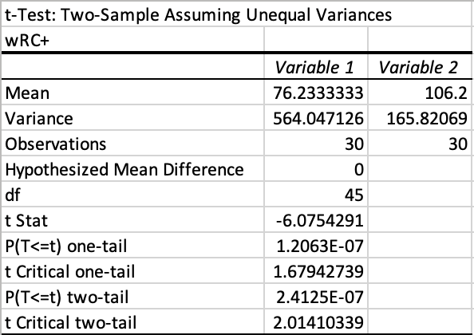
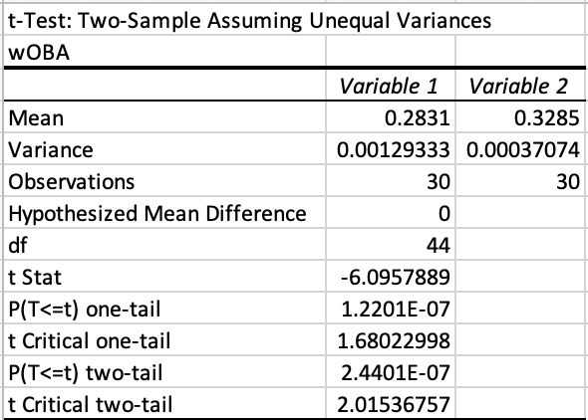
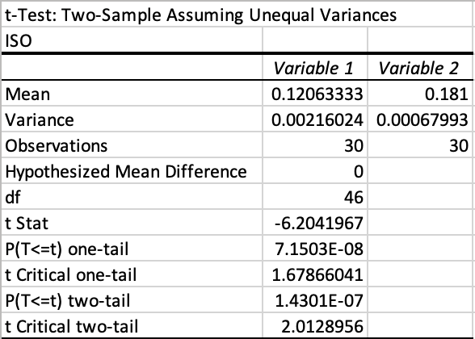
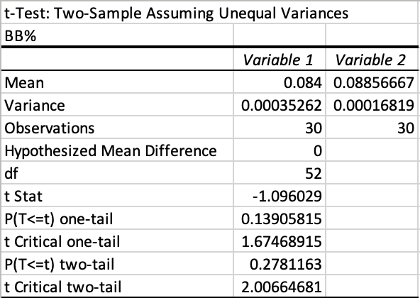
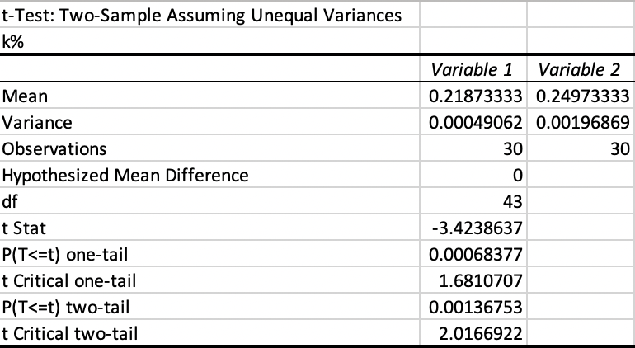
Notes:
wRC+
RESULT: p = 1.20627E-07 < ɑ = 0.05, meaning we reject the null hypothesis. Since we reject the null hypothesis, that means there is strong evidence that higher wRC+ is linked with right-handed hitting against left-handed pitching.
wOBA
RESULT: p = 1.22007E-07 < ɑ = 0.05, meaning we reject the null hypothesis. Since we reject the null hypothesis, that means there is strong evidence that higher wOBA is linked with right-handed hitting against left-handed pitching.
ISO
RESULT: p = 7.15029E-08 < ɑ = 0.05, meaning we reject the null hypothesis. Since we reject the null hypothesis, that means there is strong evidence that higher ISO is linked with right-handed hitting against left-handed pitching.
BB%
RESULT: p = 0.139058148 > ɑ = 0.05, meaning we do not reject the null hypothesis. Since we do not reject the null hypothesis, there is no evidence that bb% is linked with right-handed hitting against left-handed pitching.
K%
RESULT: p = 0.000683766 < ɑ = 0.05, meaning we reject the null hypothesis. Since we reject the null hypothesis, that means there is strong evidence that higher strikeout rate is linked with left-handed hitting over right-handed hitting against left-handed pitching.
Fair to say that there is a lot of evidence for an opposing handedness advantage for the 2021 MLB season. Let’s get more data.

Slide 8
Notes:
2019 data
vR:
Like the case with the data from 2021,
It’s very clear that there’s an advantage for left-handed hitters over right-handed hitters against right-handed pitching.
Issue of k%.

Slide 9
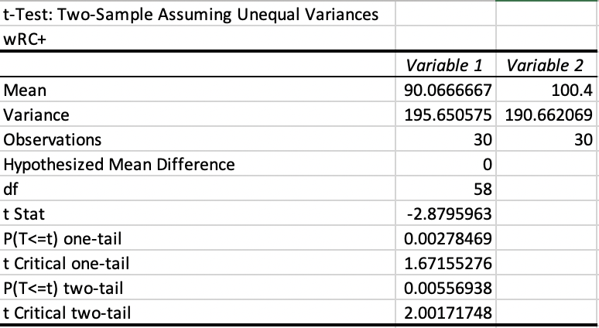
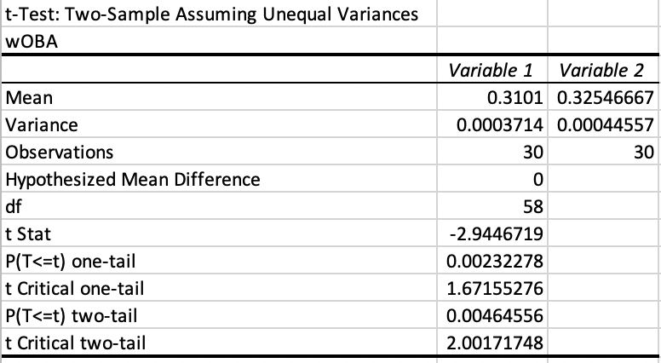
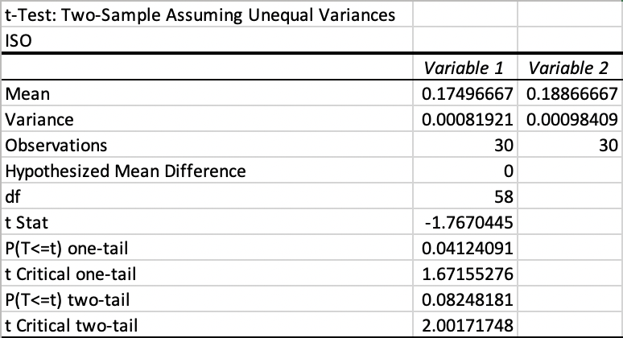
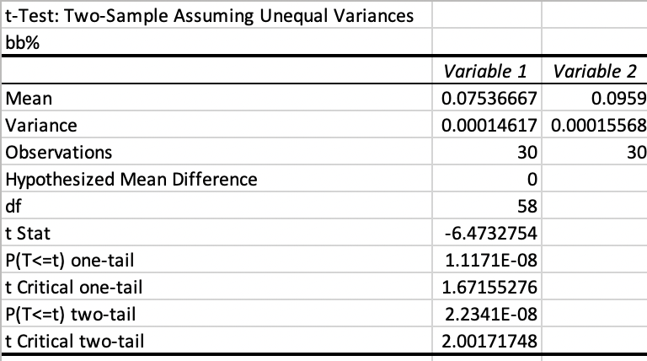
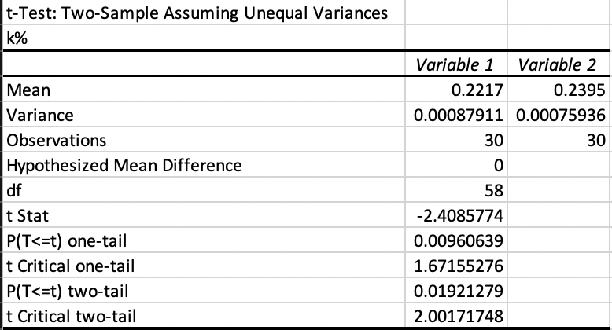
Notes:
wRC+
RESULT: p = 0.00278469 < ɑ = 0.05, meaning we reject the null hypothesis. Since we reject the null hypothesis, that means there is strong evidence that higher wRC+ is linked with left-handed hitting against right-handed pitching.
wOBA
RESULT: p = 0.00232278 < ɑ = 0.05, meaning we reject the null hypothesis. Since we reject the null hypothesis, that means there is strong evidence that higher wOBA is linked with left-handed hitting against right-handed pitching.
ISO
RESULT: p = 0.04124091 < ɑ = 0.05, meaning we reject the null hypothesis. Since we reject the null hypothesis, that means there is strong evidence that higher ISO is linked with left-handed hitting against right-handed pitching.
BB%
RESULT: p = 1.1171E-08< ɑ = 0.05, meaning we reject the null hypothesis. Since we reject the null hypothesis, that means there is strong evidence that higher bb% is linked with left-handed hitting against right-handed pitching.
K%
RESULT: p = 0.00960639 < ɑ = 0.05, meaning we reject the null hypothesis. Since we reject the null hypothesis, that means there is strong evidence that higher strikeout rate is linked with right-handed hitting over left-handed hitting against right-handed pitching.

Slide 10
Notes:
vL:
This is much more complicated.
It’s clear for wRC+, wOBA and ISO that there’s a handedness advantage however, in terms of plate discipline (both k% and bb%) it’s not that clear cut.

Slide 11
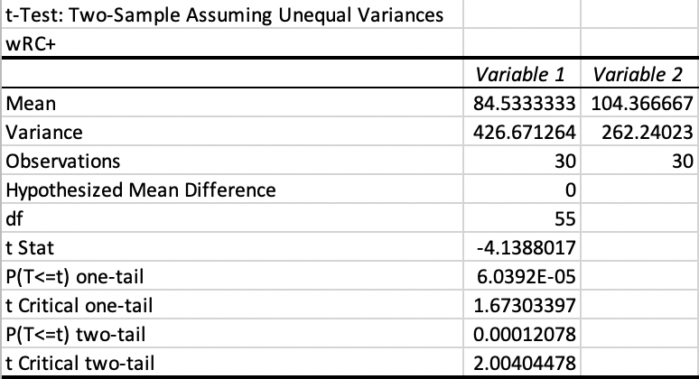
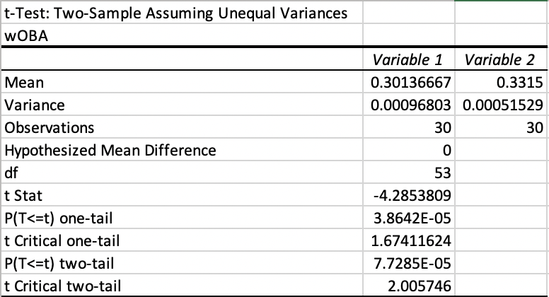
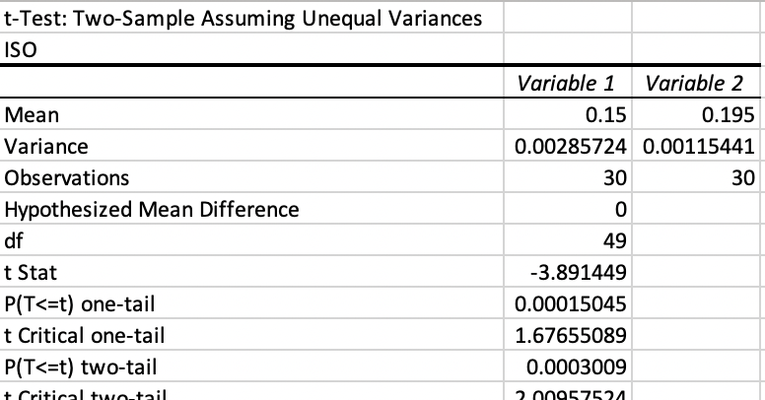
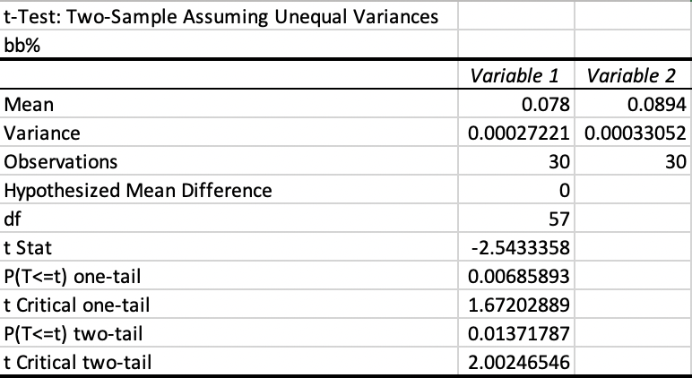
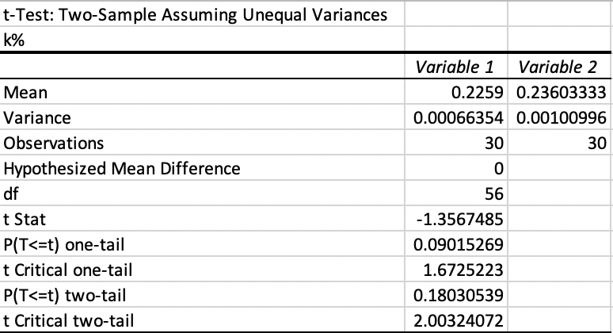
Notes:
wRC+
RESULT: p = 6.0392E-05 < ɑ = 0.05, meaning we reject the null hypothesis. Since we reject the null hypothesis, that means there is strong evidence that higher wRC+ is linked with right-handed hitting against left-handed pitching.
wOBA
RESULT: p = 3.8642E-05 < ɑ = 0.05, meaning we reject the null hypothesis. Since we reject the null hypothesis, that means there is strong evidence that higher wOBA is linked with right-handed hitting against left-handed pitching.
ISO
RESULT: p = 0.00015045 < ɑ = 0.05, meaning we reject the null hypothesis. Since we reject the null hypothesis, that means there is strong evidence that higher ISO is linked with right-handed hitting against left-handed pitching.
BB%
RESULT: p = 0.00685893 < ɑ = 0.05, meaning we reject the null hypothesis. Since we reject the null hypothesis, there is strong evidence that a higher bb% is linked with right-handed hitting against left-handed pitching.
K%
RESULT: p = 0.09015269 > ɑ = 0.05, meaning we do not reject the null hypothesis. Since we reject the null hypothesis, that means there is no evidence that higher strikeout rate is linked with left-handed hitting over right-handed hitting against left-handed pitching.
More data, 3rd year good yes good

Slide 12
Notes:
2018 data
vR:
pretty clear evidence for hitting statistics as well as plate discipline
Orange line very clearly above the blue line.

Slide 13
Notes:
wRC+
RESULT: p = 0.00158009< ɑ = 0.05, meaning we reject the null hypothesis. Since we reject the null hypothesis, that means there is strong evidence that higher wRC+ is linked with left-handed hitting against right-handed pitching.
wOBA
RESULT: p = 0.00129704 < ɑ = 0.05, meaning we reject the null hypothesis. Since we reject the null hypothesis, that means there is strong evidence that higher wOBA is linked with left-handed hitting against right-handed pitching.
ISO
RESULT: p = 0.02238039 < ɑ = 0.05, meaning we reject the null hypothesis. Since we reject the null hypothesis, that means there is strong evidence that higher ISO is linked with left-handed hitting against right-handed pitching.
BB%
RESULT: p = 8.2184E-11< ɑ = 0.05, meaning we reject the null hypothesis. Since we reject the null hypothesis, that means there is strong evidence that higher bb% is linked with left-handed hitting against right-handed pitching.
K%
RESULT: p = 0.01075384 < ɑ = 0.05, meaning we reject the null hypothesis. Since we reject the null hypothesis, that means there is strong evidence that higher strikeout rate is linked with right-handed hitting over left-handed hitting against right-handed pitching.

Slide 14
Notes:
vL:
Very clearly true for hitting stats, but again it’s not as true for plate discipline. Might be a trend… is there a definitive LvR advantage over RvR, but it is not as true for RvL over LvL in terms of PD?

Slide 15
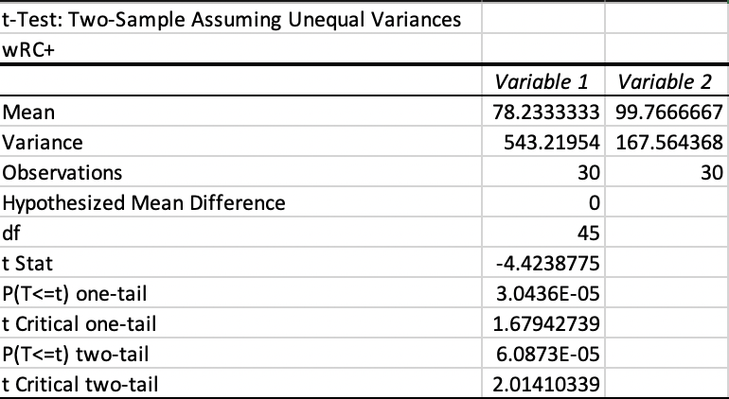
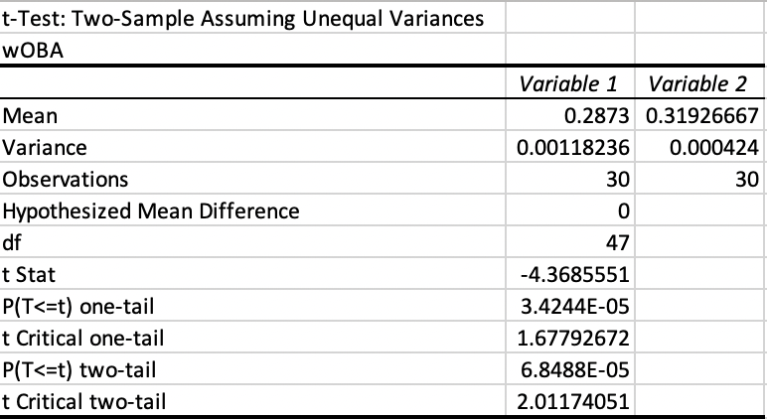
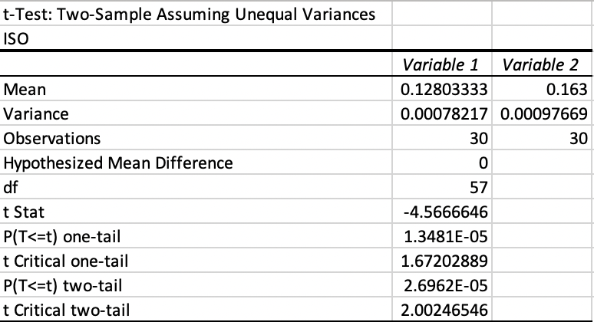


Notes:
wRC+
RESULT: p = 3.0436E-05 < ɑ = 0.05, meaning we reject the null hypothesis. Since we reject the null hypothesis, that means there is strong evidence that higher wRC+ is linked with right-handed hitting against left-handed pitching.
wOBA
RESULT: p = 3.4244E-05 < ɑ = 0.05, meaning we reject the null hypothesis. Since we reject the null hypothesis, that means there is strong evidence that higher wOBA is linked with right-handed hitting against left-handed pitching.
ISO
RESULT: p = 1.3481E-05 < ɑ = 0.05, meaning we reject the null hypothesis. Since we reject the null hypothesis, that means there is strong evidence that higher ISO is linked with right-handed hitting against left-handed pitching.
BB%
RESULT: p = 0.02411808 < ɑ = 0.05, meaning we reject the null hypothesis. Since we reject the null hypothesis, there is strong evidence that a higher bb% is linked with right-handed hitting against left-handed pitching.
K%
RESULT: p = 0.00074997 < ɑ = 0.05, meaning we reject the null hypothesis. Since we reject the null hypothesis, that means there is strong evidence that higher strikeout rate is linked with left-handed hitting over right-handed hitting against left-handed pitching.

Slide 16
Do teams build their lineups based on their ballparks?
We can use park factors from FanGraphs, and filter factors by handedness, to see which teams have an advantage for left-handed or right-handed hitters.

Slide 17
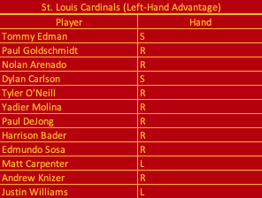
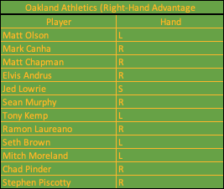
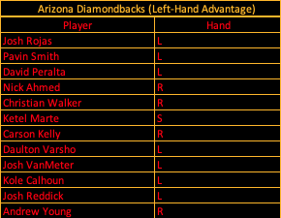
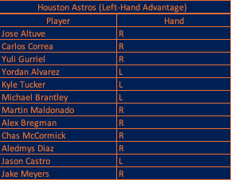
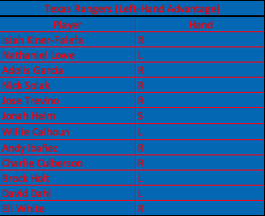
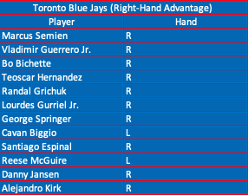
Notes:
The blue jays and athletics clearly do, also adding on to the fact right-handed hitters are just more common.
The Dbacks are indifferent but have a good balance of left and right-handed hitters.
The Astros cardinals and rangers all do not use their parks to their advantage in roster construction.

Slide 18
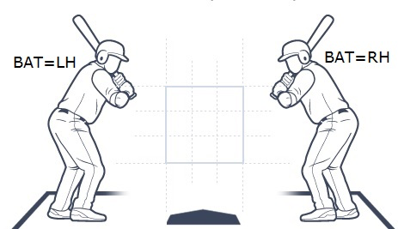
Notes:
It can be very helpful in team building
Building a lineup with more left-handed hitters or attempting to build a platoon like lineup
Lineup v. L or Lineup v. R
Good switch hitters can be advantageous
Building a pitching staff with a balanced rotation to possibly strategically matchup against certain lineups
Lineups with more left-handed or right-handed hitters
Or set up bullpen scenarios
Have like 6-7 capable starters and 6-7 bullpen pitchers
I’m sure markets already do this, but if you have a team with a lot of hitters of one side, the opposing pitchers' hand could play a role in betting on them.
Overall, it is fair to say that there is a hitting advantage for opposing handedness. In every single graph for wRC+, wOBA and ISO, there is a very clear difference between the lines for opposing versus same hand. With the same hand always having their data higher.
Additionally, we reject the null hypothesis for every test by hand for wRC+, wOBA and ISO, meaning there are 3 pieces of strong evidence that there is a handedness advantage for hitters against each hand (both left and right-handed pitching).
While the case is not as strong for strikeout and walk rates, in every graph except for 2, there’s still some evidence to suggest that walk rates go up and strikeout rates go down opposing hand batters.

